Slide 1



Slide 2





Slide 3





Slide 4





-
-
-

Slide 5






-
-
-

Slide 6











01101110
-
•
-
•

Slide 7
01101110
InputStream
int read()
Reader
int read()

Slide 8
InputStream input = // create input stream
int intVal;
while ((intVal = input.read()) >= 0) { byte byteVal = (byte) intVal;
// do something with byteVal
}

Slide 9
Reader reader = // create reader
int intVal;
while ((intVal = reader.read()) >= 0) { char charVal = (char) intVal;
// do something with charVal
}

Slide 10
01101110
InputStream
int read()
int read(byte[] buff)
Reader
int read()
int read(char[] buff)

Slide 11

InputStream input = // create input stream int length;
byte[] byteBuff = new byte[10];
while ((length = input.read(byteBuff)) >= 0) {
for(int i=0; i < length; i++) { byte byteVal = byteBuff[i];
// do something with byteVal
}
}

Slide 12
Reader reader = // create reader int length;
char[] charBuff = new char[10];
while ((length = reader.read(charBuff)) >= 0) {
for(int i=0; i < length; i++) { char charVal = charBuff[i];
// do something with charVal
}
}

Slide 13
01101110
InputStream
int read()
int read(byte[] buff)
Reader
int read()
int read(char[] buff)
OutputStream
void write(int b)
void write(byte[] buff)

Slide 14

OutputStream output = // create output stream
byte byteVal = 100;
output.write(byteVal);
byte[] byteBuff = {0, 63, 127};
output.write(byteBuff);

Slide 15
01101110
InputStream
int read()
int read(byte[] buff)
Reader
int read()
int read(char[] buff)
OutputStream
void write(int b)
void write(byte[] buff)
Writer
void write(int ch)
void write(char[] buff)
void write(String str)

Slide 16

Writer writer = // create writer
char charVal = ‘a’; writer.write(charVal);
char[] charBuff = {‘a’, ‘b’, ‘c}; writer.write(charBuff);
String stringVal = “Hello World”; writer.write(stringVal);

Slide 17











Slide 18













Slide 19




Slide 20


-
-
-
•

Slide 21
Reader reader; try {
reader = // open reader
// do something with reader
} catch(IOException e) {
// handle exception
} finally {
try {
if(reader != null)
reader.close();
} catch(IOException e2) {
// handle exception
}
reader.close();
}

Slide 22








-
-
-
interface AutoCloseable {
void close() throws Exception;
}
interface Closeable extends AutoCloseable { void close() throws IOException;
}

Slide 23








-
•
-
-
•
•

Slide 24








-
-
-
-
-
-

Slide 25



void doChain(InputStream in) throws IOException {
int length;
char[] charBuff = new char[128];
try (InputStreamReader rdr = new InputStreamReader(in)) {
while((length = rdr.read(charBuff)) >= 0) {
// do something with charBuff
}
}
}

Slide 26








-
•
-
-
-
-

Slide 27






-
-
-
-
-

Slide 28









-
-
-
-
-
-
-

Slide 29

try (BufferedReader br =
new BufferedReader(new FileReader(“file1.txt”))) { int intVal;
while((intVal = br.read()) >= 0) { char charVal = (char) intVal;
// do something with charVal
}
}

Slide 30












-
•
-
•
-
-
•
-
•

Slide 31
void writeData(String[] data) throws IOException {
String[] data = { “Line 1”,
“Line 2 2”,
“Line 3 3 3”,
}
 | “Line | 4 | 4 | 4 | 4”,
 | “Line | 5 | 5 | 5 | 5 5”
}

Slide 32
void writeData(String[] data) throws IOException { try (BufferedWriter bw =
new BufferedWriter(new FileWriter(“data.txt”))) { for(String d:data) {
bw.write(d);
Line 1Line 2 2Line 3 3 3Line 4 4 4 4Line 5 5 5 5 5
}
}
}

Slide 33
void writeData(String[] data) throws IOException { try (BufferedWriter bw =
new BufferedWriter(new FileWriter(“data.txt”))) { for(String d:data) {
bw.write(d);
bw.newline();
}
}
}
Line | 1
Line | 2 | 2
Line | 3 | 3 | 3
Line | 4 | 4 | 4 | 4
Line | 5 | 5 | 5 | 5 | 5

Slide 34

void readData() throws IOException { try (BufferedReader br =
new BufferedReader(new FileReader(“data.txt”))) { String inValue;
while((inValue = br.readLine()) != null) {
 |  |  | System.out.println(inValue); | Line | 1
 |  | } |  | Line | 2 | 2
 | } |  |  | Line | 3 | 3 | 3
} |  |  |  | Line | 4 | 4 | 4 | 4
 |  |  |  | Line | 5 | 5 | 5 | 5 | 5

Slide 35
Random Access File class

Slide 36

Class Declaration

Slide 37
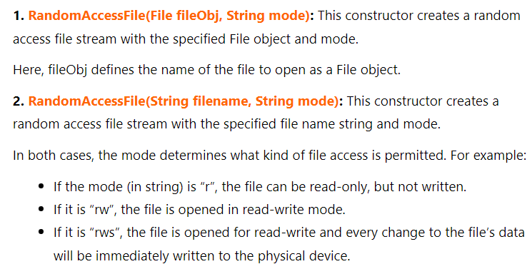

Constructors of RandomAccessFile class

Slide 38
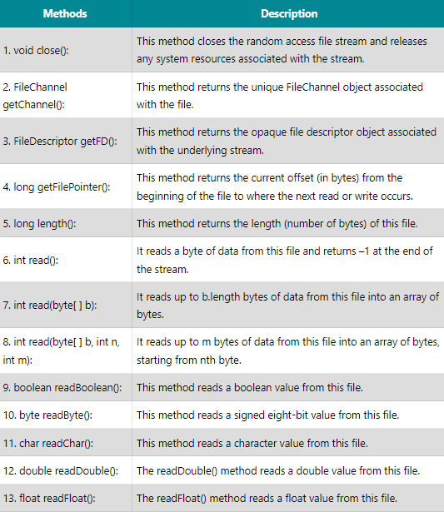
RandomAccessFile Methods in Java

Slide 39
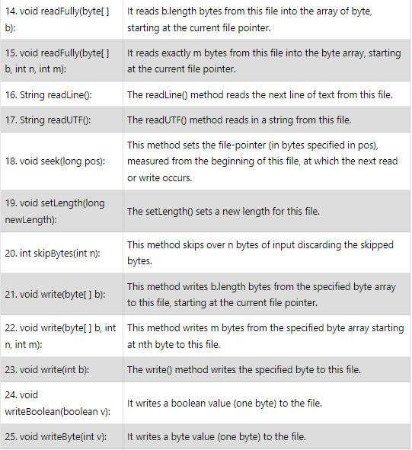
RandomAccessFile Methods in Java(contd.)

Slide 40
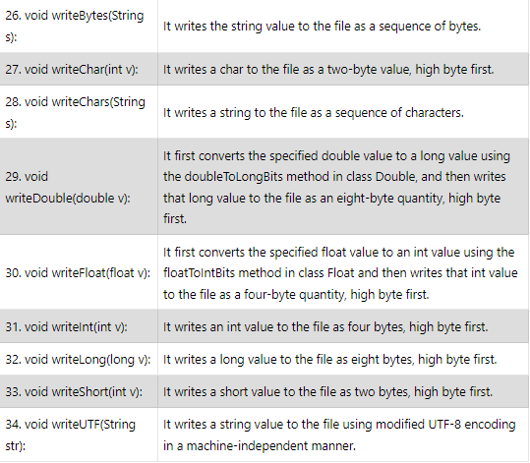
RandomAccessFile Methods in Java(contd.)

Slide 41


Creating and Using a Random Access File object
Create a random access file object.
Writing to the file.
Reading data from the file.
Moving the file pointer to the second item.
Go to the end and append a boolean value to the file.
Since pointer is at the end, beyond the 4th item, bring the file pointer to the 4th item in the file.

Slide 42
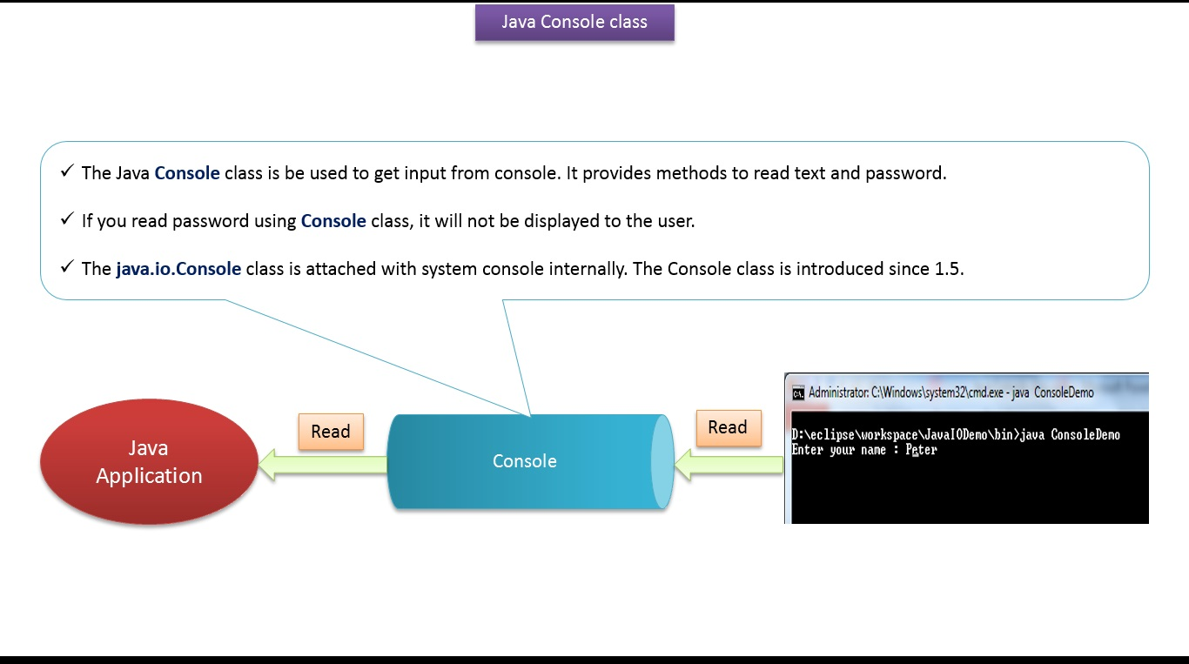
Java.io.Console class

Slide 43
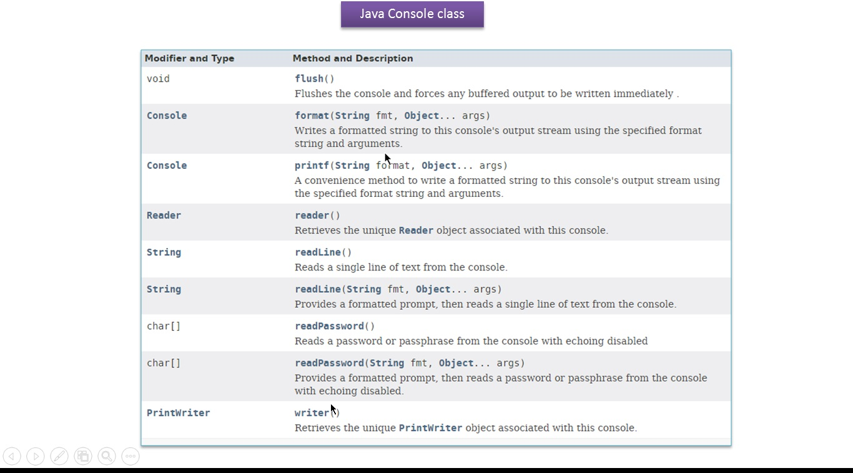
Java.io.Console methods

Slide 44
ConsoleDemo.java
Read and write the user’s username from the console.
Read and write the user’s password from the console.

Slide 45




-
-
-

Slide 46






-
-
-
-
-
-

